Slide 1
Improving Edge-Assisted CNN Detection Accuracy thro’ Flexible Pipeline Tuning

Slide 2
Prior Work
Total Detection latency = Computational latency + Communication latency
Prior works (DeepMon [Mobisys’17], Mcdnn [Mobisys’16]) focuses optimizing Computational latency only using some local scheduling algorithms
Notes:
Prior works (DeepMon [Mobisys’17] using HW accelerator in the form of GPU, Mcdnn [Mobisys’16] how to schedule heterogeneous requests in a resource constraint environment) focuses optimizing computational latency only using some local scheduling algorithms.
This motivates the need for self driving network. Where when the application is performing bad react to those situations and improve the user experience.
Current methods of enhancing the application performance static, unresponsive to network changes and don’t consider real user exp

Slide 3
Observations → Where is the Bottleneck?
But for remote execution,
communication time >> computation time
Network condition can be heavily shifted
decrease by 10.33 times during peak hours for LTE
This variation would affect most for edge device – edge server communication (last hop)
Edge devices have resource constraints
Drain out battery rapidly while computation-intensive DNN tasks
Notes:
18.65 for WiFi hotspot (Network condition)
Finding where is the bottleneck?

Slide 4
Why Local-Remote Execution is not a Good Solution?
Consider a local model is currently being used and network BW got improved and system decides to offload
Network BW increased temporarily, it may be suboptimal to switch due to cost overhead
Suboptimality in network BW and time dynamics

Slide 5
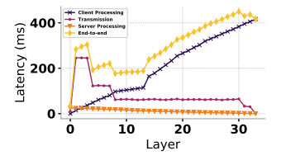
Why Partitioning DNN not a good solution?
Intermediate output of a CNN model such as feature maps 10X than inputs
Client-side latency and communication overhead keeps on increasing
For Resource-constraint end devices (drones), remote execution seems to be the best solution with availability of network BW
Notes:
Either offload completely or execute completely locally
How to compress the intermediate output and which layer to compress in order to have best compression ratio

Slide 6
Why Cloud processing is the best?
It will keep the model private as opposed to Federated learning
Cloud based approaches provide benefits such as
centralized model management
ability to execute deeper and more complex CNN models

Slide 7
What’s State of the Art doing?
Running object detection in each frame is very costly hence recent papers use object tracking in each frame with occasional object detection.
First do the object detection get a list of images then track those list of images before next object detection triggers
Problem: If new object appears and system is not taking care of then it will remain undetected for next set of frames (this is problematic for drones)
Hence, we have to run object detection on each and every frame

Slide 8
Problem Statement
How to get the best possible detection accuracy under different network conditions given a time constraint for a real-time CNN-based object detection application?
Application → Pinpointing objects using Drone Camera Network
Notes:
Highly used in disaster management
Fixed constraint = total detection time
Variable constraint = network BW
Ultimate QoE = accuracy
This ultimate QoE can be impact by several factors

Slide 9
Two Tunable Inputs
Video content
CNN Model
Now, how to adaptively reduce network BW requirement based on input video content???

Slide 10
Design Choice I: Resizing the Image
Scaling
Cropping
Seam Carving
AdaScele [sysML’19] only focuses on downsample size, this parameter is used as a tuning parameter in multiple other papers
Notes:
Adascle comes to the observation that downsampling could reduce noises and can reduce false positives so how to determine how much each image to scale to improve the accuracy.
They didn’t use the downscaling as a trade off parameter for accuracy and speedup.

Slide 11
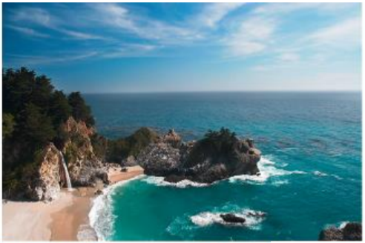
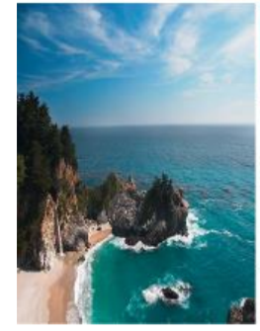
Scaling
Introduce linear global distortion

Slide 12
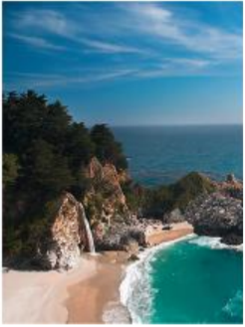
Cropping
May remove important parts

Slide 13
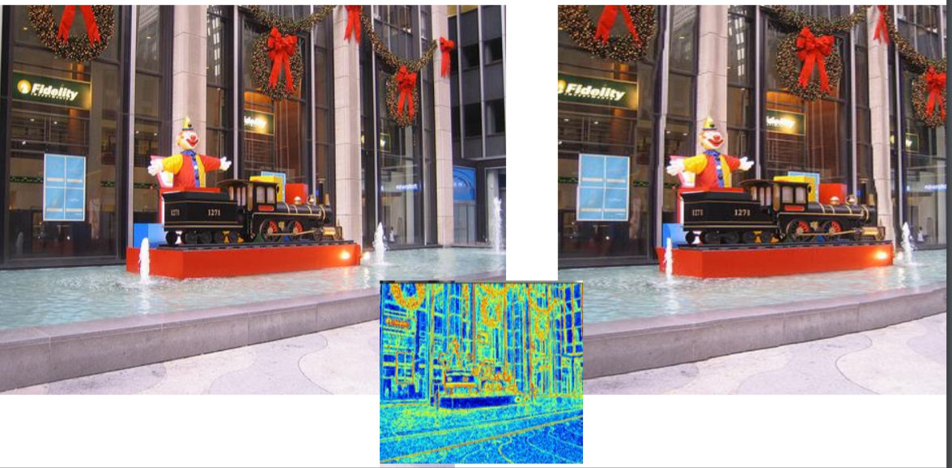
Seam Carving
(content aware scaling)
Time Consuming
Seam: Remove the vertical curve of lowest energy
Notes:
Any paper does this?

Slide 14
Design Choice II: Drop Unnecessary Frames
Sample Video at different (lower) frequencies
But not good for high motion videos with less temporal locality
Notes:
Based on video temporal locality and available net BW propose an ML model to predict the frequency

Slide 15
Design Choice II: Compression (Encoding + Decoding)
Appropriate bitrate and QP selection based on network BW
Edge Assisted Real-time Object Detection for Mobile Augmented Reality [Mobicom’19] uses encoding and decoding
but is not adaptive
Notes:
Here we can train an ML model which selects appropriate QP and Video bit-rate based on network BW

Slide 16
Assumption about Network BW
Condition of wireless link is highly dynamic and unstable
But for a small time period, its almost stable
Entire network bandwidth needs to be fully utilized

Slide 17
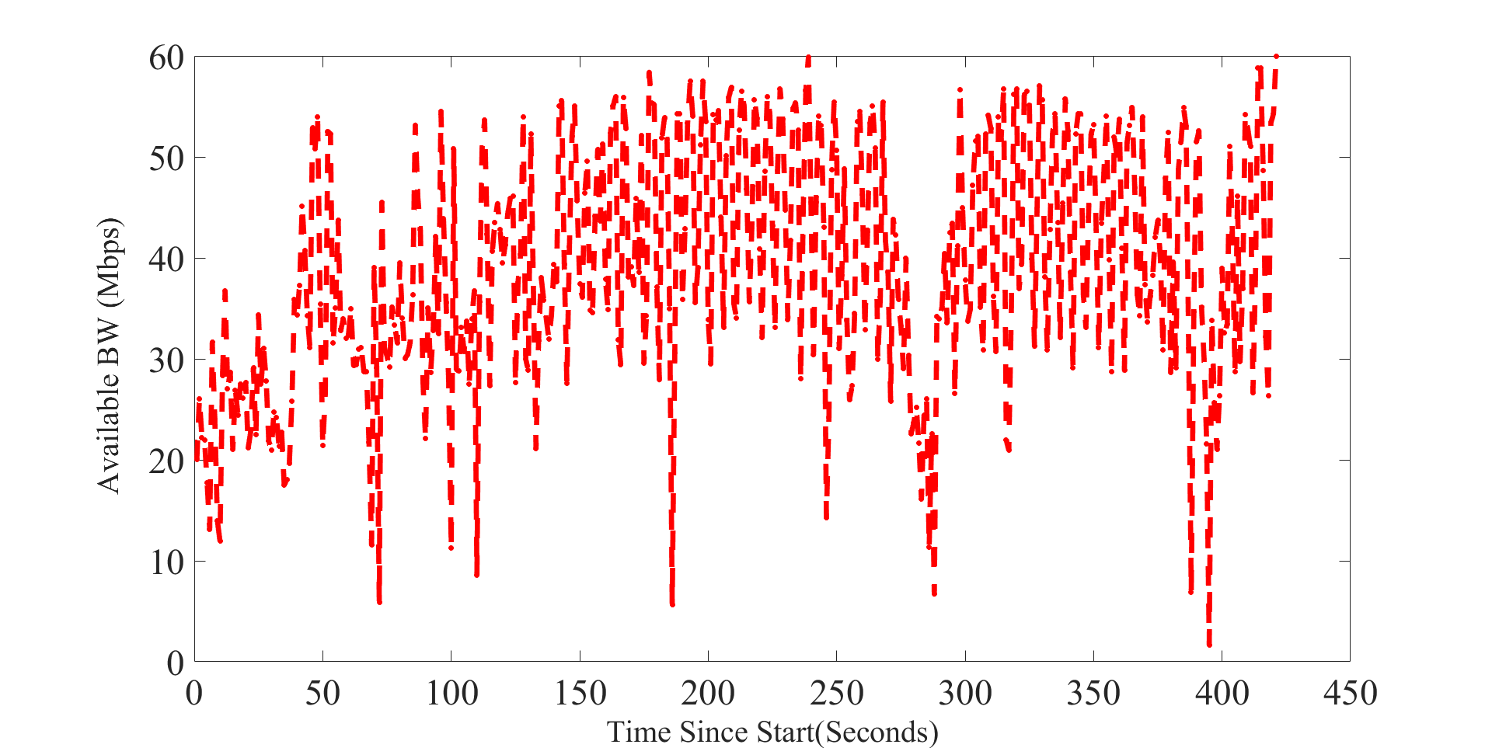
LTE Transmission BW
4G/LTE available bandwidth under walking condition
BW varies around 20-40 Mbps
Maximum BW can be around 80 Mbps
For further experiments, we considered
available BW set = {20, 40, 60, 80} Mbps
Dataset- https://users.ugent.be/~jvdrhoof/dataset-4g/

Slide 18
Let’s look into how individual content reduction algorithm impact the overall accuracy

Slide 19
Experimental Setup
Object Detection Model used – Yolov3
75 cnn-layers + 31 other layers = 106 layers
Latency Constraint ~ 100 ms (Drone Camera Object Detection)
On Edge server, execution of Yolov3 takes ~ 25-30 ms
Hence for Transmission we have 70-75 ms time constraint
First we find out maximum possible
Downscaling parameter
PNG (lossless)
JPEG (lossy)
Quantization Parameter
Frequency of sending raw frames
that satisfy the transmission time requirement under different network conditions.
Network latency constitutes 75% of the total latency

Slide 20
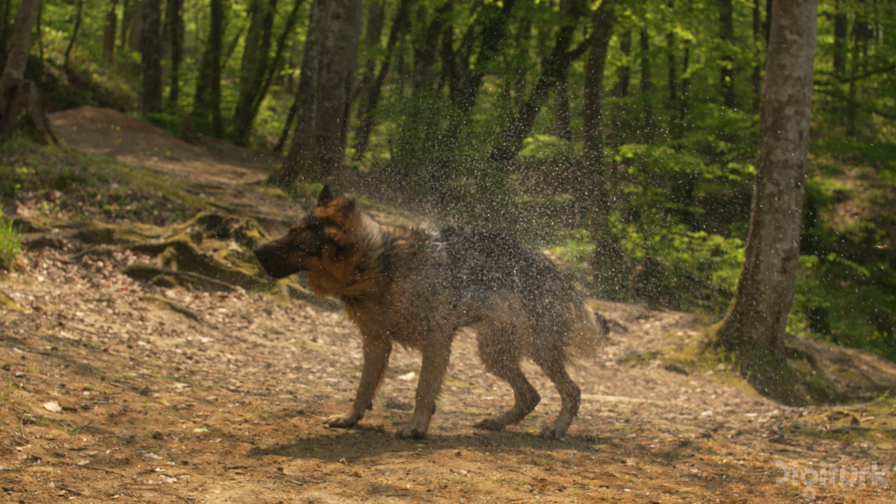
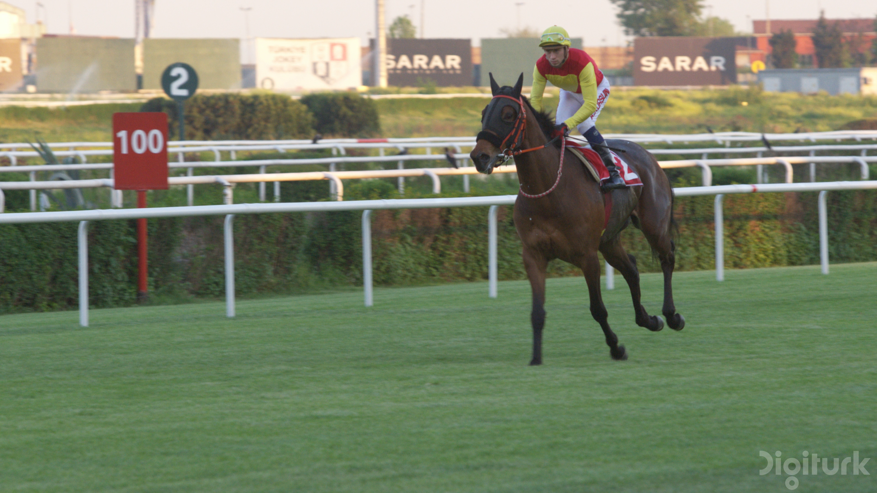
1-Dominant Obj video
2-Dominant Obj video
Under different network conditions,
Four different downscaling parameter used
{352, 480, 608, 704}
Four different QP values used
{22, 24, 28, 37}
Under different network conditions,
Four different downscaling parameter used
{352, 480, 608, 704}
Four different QP values used
{20, 25, 29, 35}
Under different network conditions, quantization parameter and downsizing parameter values highly dependent on the available video content

Slide 21
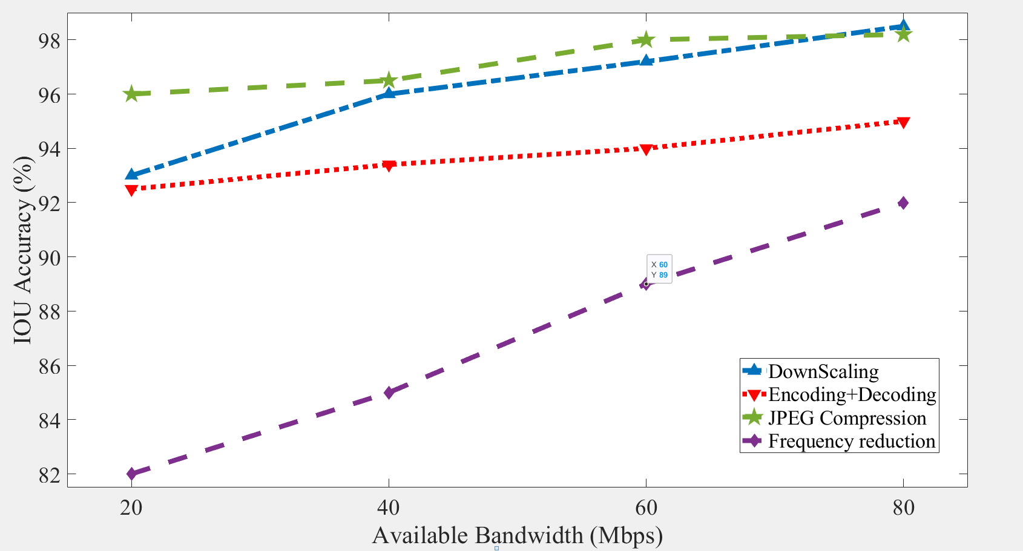
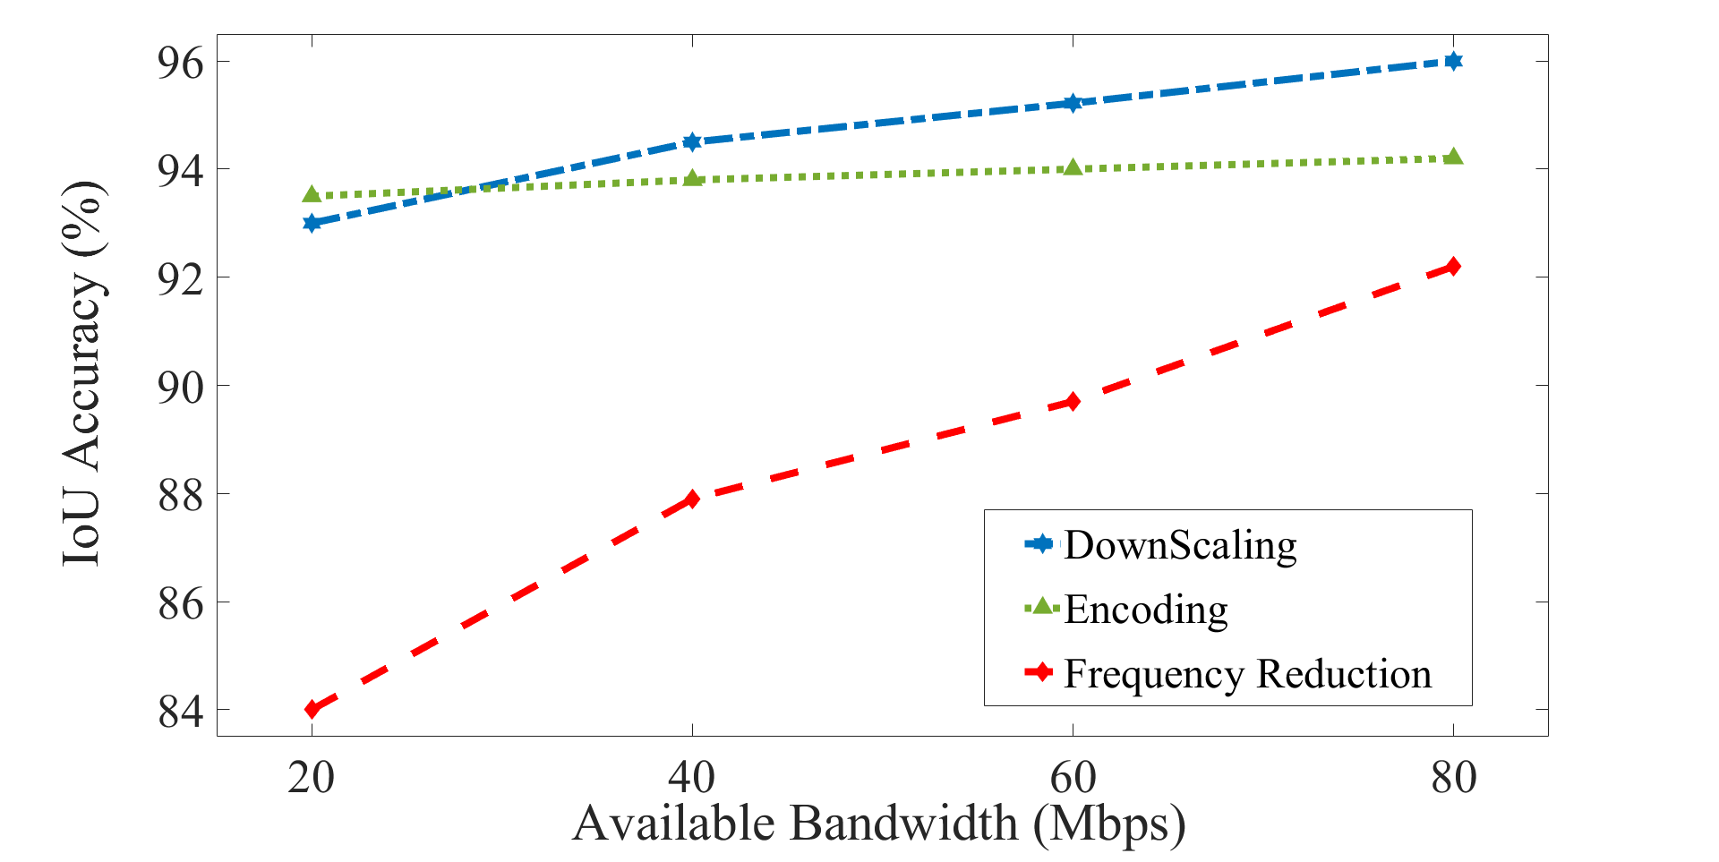
Impact on Detection Accuracy
one dominant object
2-dominant objects

Slide 22
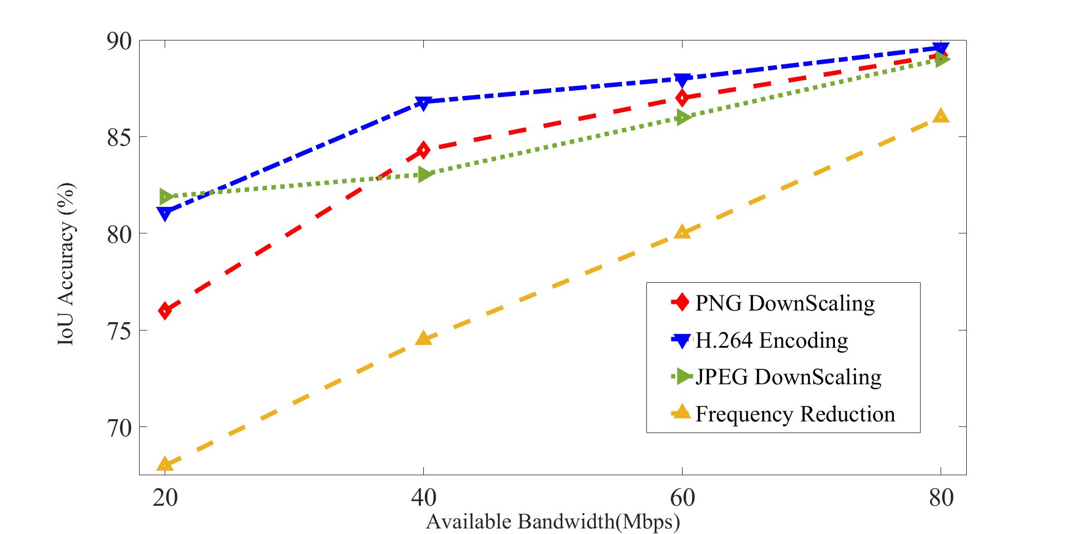
Changing the Resolution before first Convolution Layer (1024)
Observation 1: Increasing the resolution of the image passing through the first convolution layer of CNN broaden the performance gap differences among various methods
Observation 2: For lower available bandwidth ranges the performance gap much higher compared to the higher available bandwidth ranges
(except for JPEG lossy compression)
Notes:
For 60 Mbps, the downscale parameter = 672 and for 80 Mbps its 768.
This differences much higher in the lower bandwidth ranges
With 1K avg obj detection per frame increased to 3 from 1.1

Slide 23
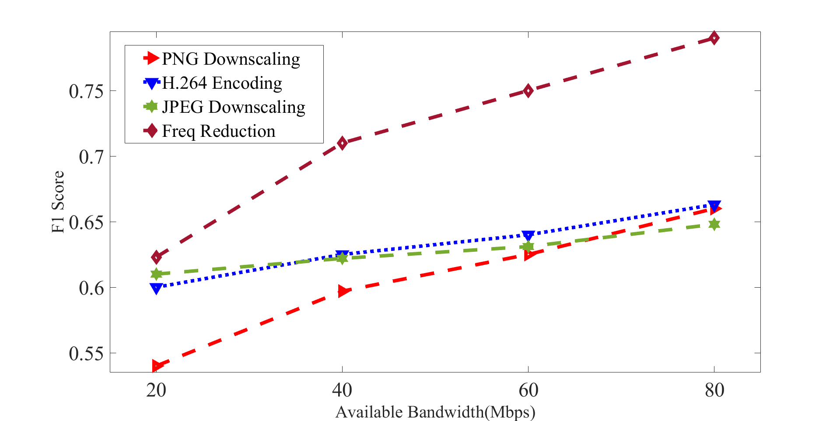
Using Smaller Models (Tiny-YOLO)
Relatively smaller models are more sensitive to change in
content compression algorithms
Parameter selection
Under Frequency reduction
Recall is much higher
Precision is much lower
Compared to other schemes
Which scheme will work best not only dependent on the network bandwidth but also dependent on the model being used by the edge server
Notes:
Suboptimality can be present while switching from one mechanism or from one parameter of one mechanism to another with the sudden change in BW but less resource will be wasted as those are lightweight processes.

Slide 24
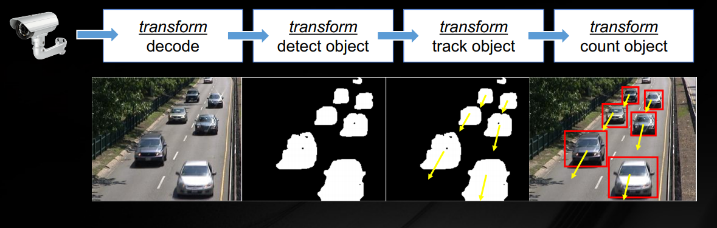
Video Analytics Pipeline
Existing work considers fixed detection classification pipelines which incorporates different modules like decoder, obj classifier

Slide 25
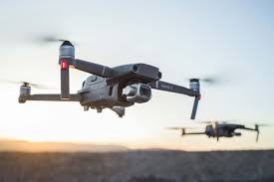

Fixed Object-Detection Pipeline
Server Side
Pre-Processing
Stage
CNN Execution
Raw
Input
Preprocessed
Input
Preprocessed
Input
Class
BBox
Network Tx
Downsizing
JPEG Compression
Encoding
Frequency Reduction
Client Side

Slide 26
Modified Problem Formulation II
Need to set Downsizing parameter, QP in encoding, JPEG Compression, Frequency of sending frames jointly which in turn restrict the transmission size less than allowable limit
Apply Lightweight ML (in pre-execution step) in order to select best possible parameter tuning for input of CNN detection?

Slide 27
Fixed(few modules) vs Flexible (numerous Ops)
Previous work has fixed video analytics pipeline, once deployed executed for ever
Previous works don’t consider how different preprocessing algorithms on client and server side along with the model used for detection can be visualized as a flexible pipeline
Each operators of this flexible pipeline can be turned on/off (Boolean)
Each ops in the pipeline can be tuned in a content aware way to find the best possible accuracy under deadline (Continuous)

Slide 28
Flexible Pipeline of Operators
Client Side
Server Side
OP₁
OP₂
OP₃
OP_{N-1}
OP_{N}

Slide 29
Impact of These Operators
Client Side (OP_{client})
T_{t} + T_{c} < T_{threshold}
Server Side (OP_{server})
Computation Time, T_{c}
Input
Image
ML model
OP₁, OP₂, OP₃, ….
OP_{N}
Transmission Time, T_{t}
Few operators will change the transmission time (Op_{client})
Few operators will change the computation time (op_{server)}
Any change in this operators can change in accuracy

Slide 30
What are these Operators?
OP_{client} includes
Downsizing (OP₁), Encoding (OP₂) , JPEG Compression (OP₃), Freq reduction (OP₄)
OP_{server} includes
Which model to choose (OP₅)
Any existing algorithm (likewise DeepMon, DeepCache) can also be considered as one operator and our modified ML model will choose whether to select those operators or not.

Slide 31
Pipeline of Operators (Explored)
Order of the operators is fixed
Client Side
Server Side
Computation Time
OP₁
OP₂
OP₃
OP₄
OP₅
Transmission Time
Downsizing
JPEG compression
H.264 encoding
Freq reduction
Model Selection
Downsizing parameter
Yes/No
Frequency value
Different Models
QP
How to determine likely optimal operator configurations?

Slide 32
Let’s look into how multiple configurations for three content reduction algorithms jointly impact the overall accuracy

Slide 33
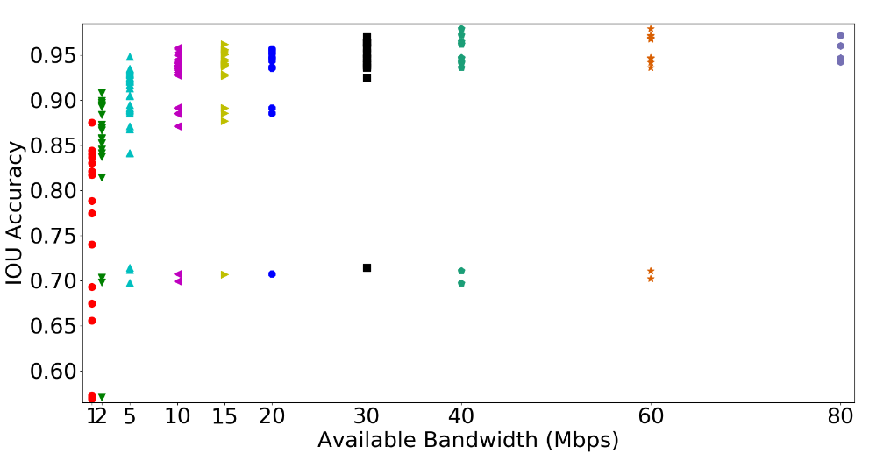
Accuracy vs Available BW
186 different configurations are plotted
Each configurations resulted different outcomes
For example, best configuration for bandwidth 5 under those 3 operators
Downsize image by 960
JPEG compression
Encode with QP 28
Best configuration doesn’t correspond to maximum size.
Sometimes it less than the mean of sizes available across all configurations
Notes:
For bw 20, best configuration downsize 960 no jpeg and encode with qp 12

Slide 34
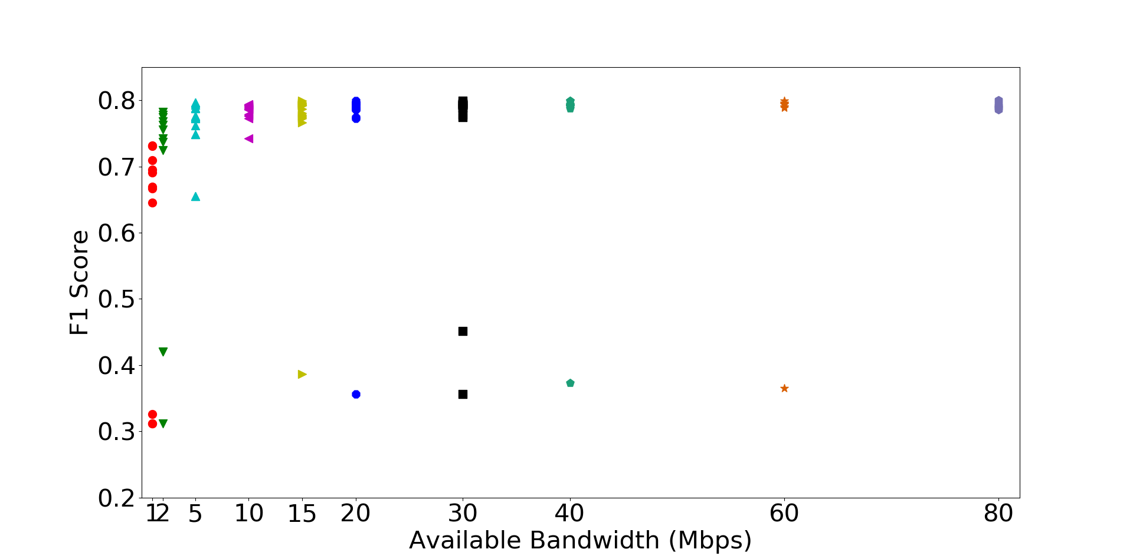
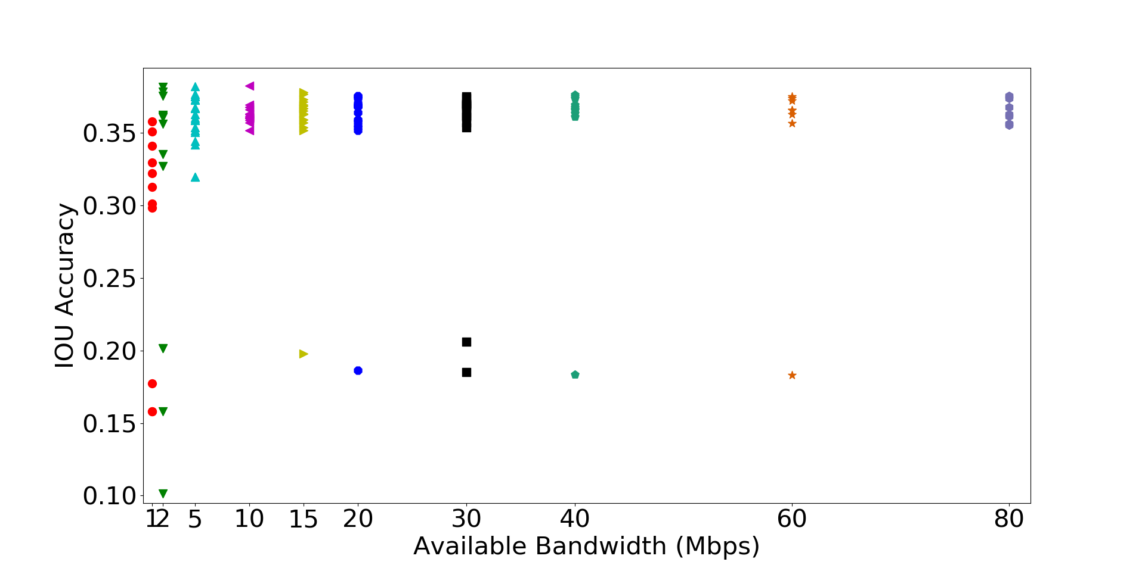
Accuracy vs Available BW (Different Model)
We use lighter model (tiny yolo) in order to check the effect
Tiny yolo can finish the computation on server 1.67x times faster
Hence we can accommodate larger size pre-processed frames for communication
Notes:
We use F1 score here as bounding box based accuracy is really less for tiny yolo

Slide 35
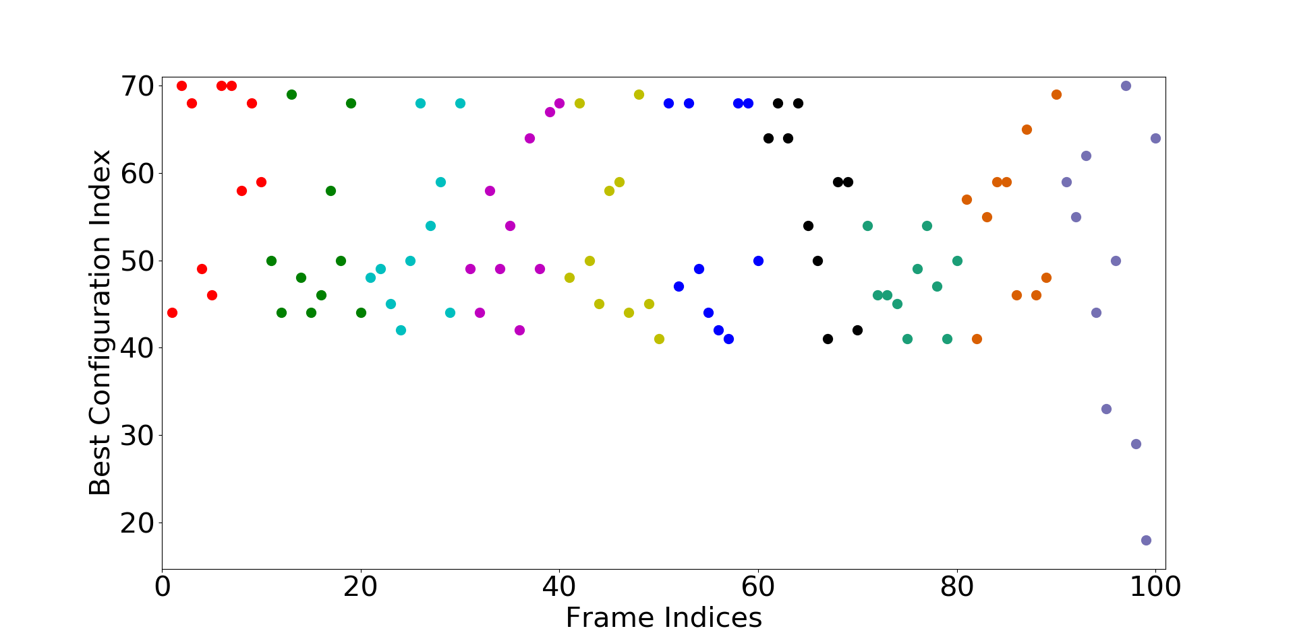
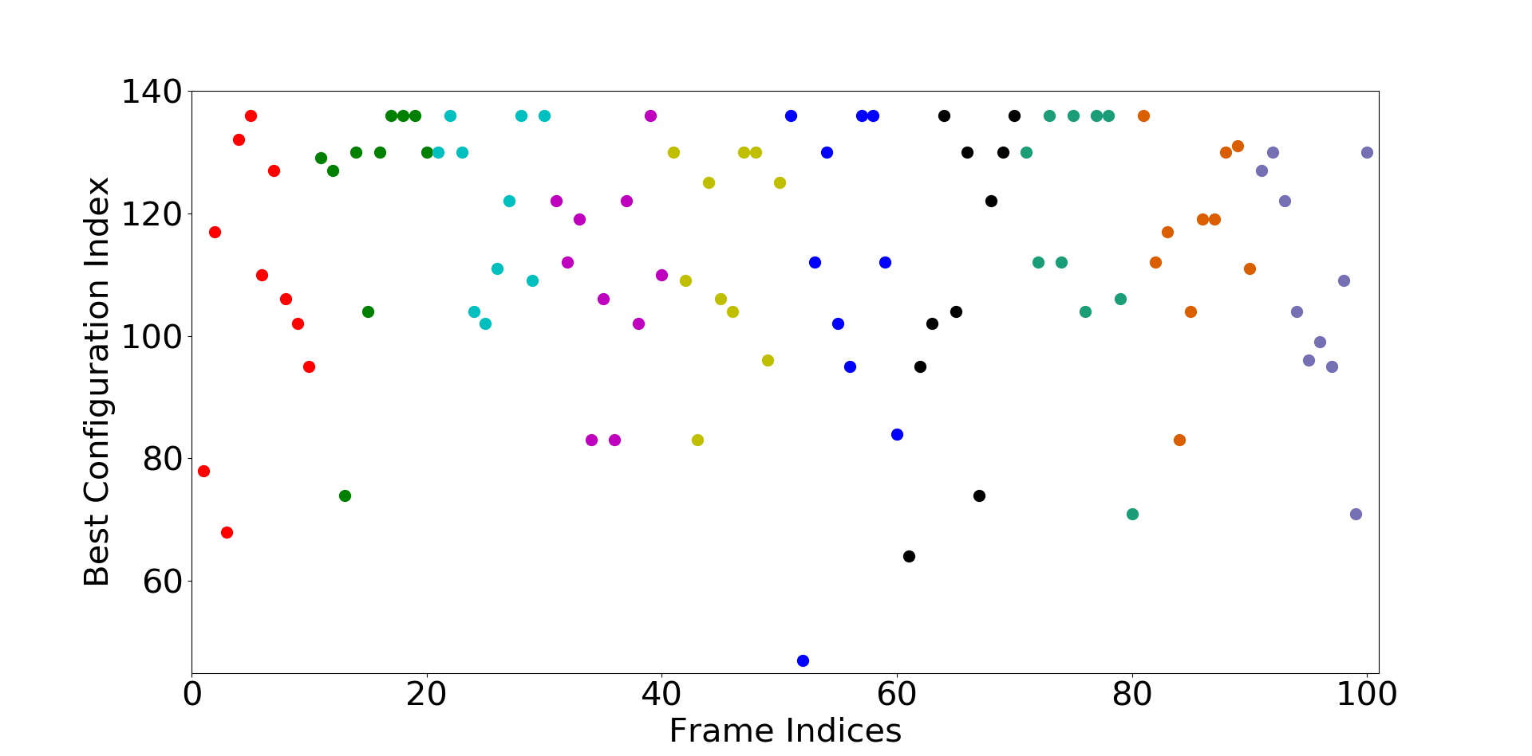
Best Configuration varies over Content
For consecutive frame indices in a video, best configuration also varies for the same network budget
This motivates us to drive the preprocessing in a content-aware way
5 Mbps
20 Mbps

Slide 36
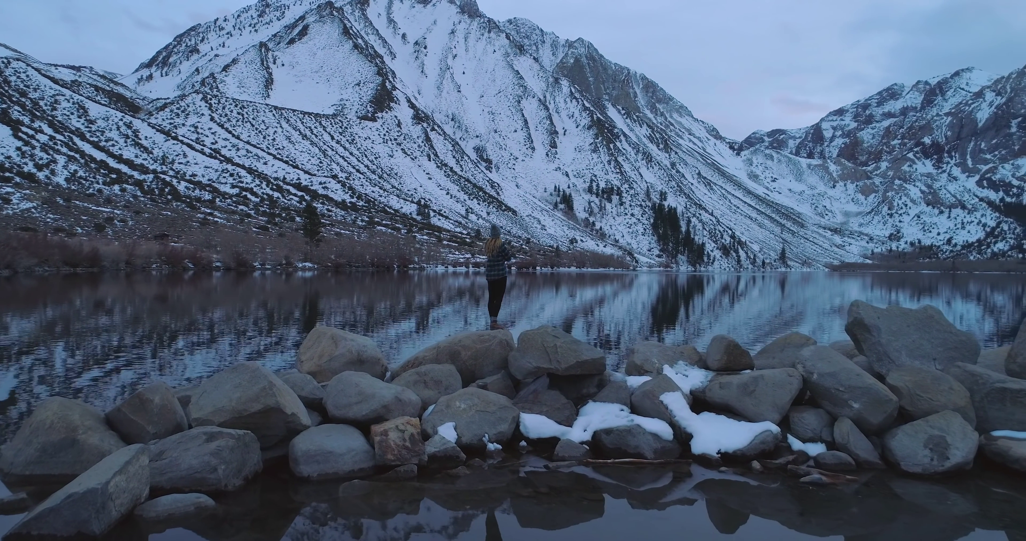
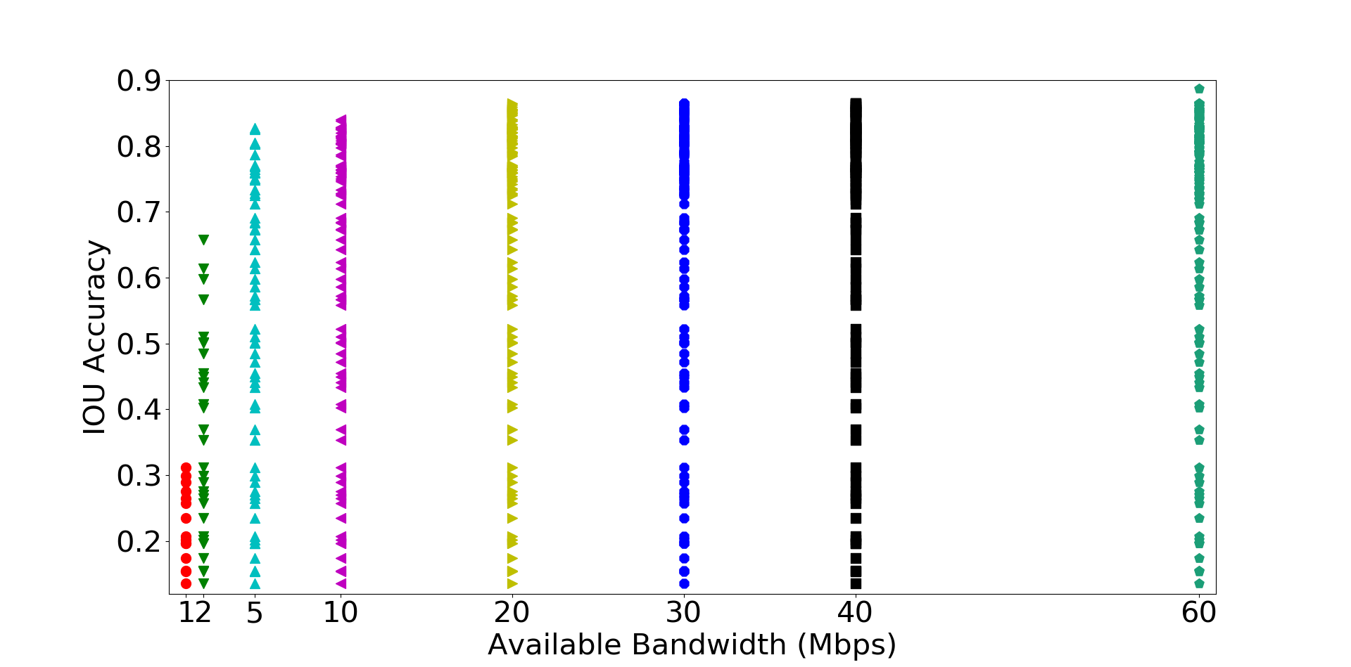
For Drone Captured Images
Accuracy variation over all possible configurations (134) using full YOLO model

Slide 37
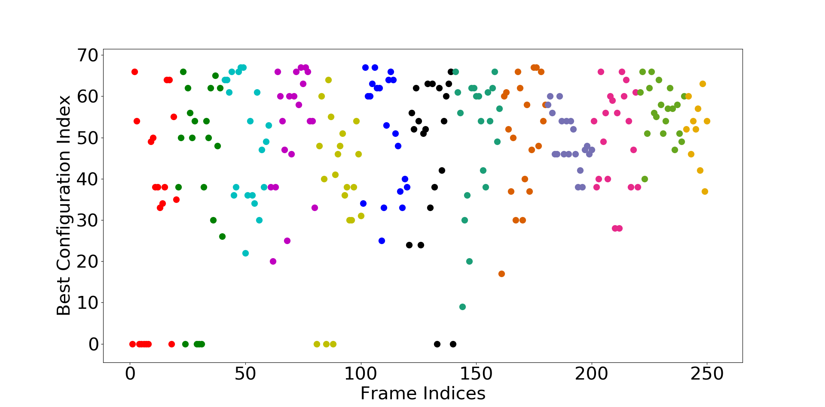
Best Configuration varies from Frame to frame
Here also best configuration varies from frame to frame
Only 19 consecutive frames have same configuration over 249 frames

Slide 38
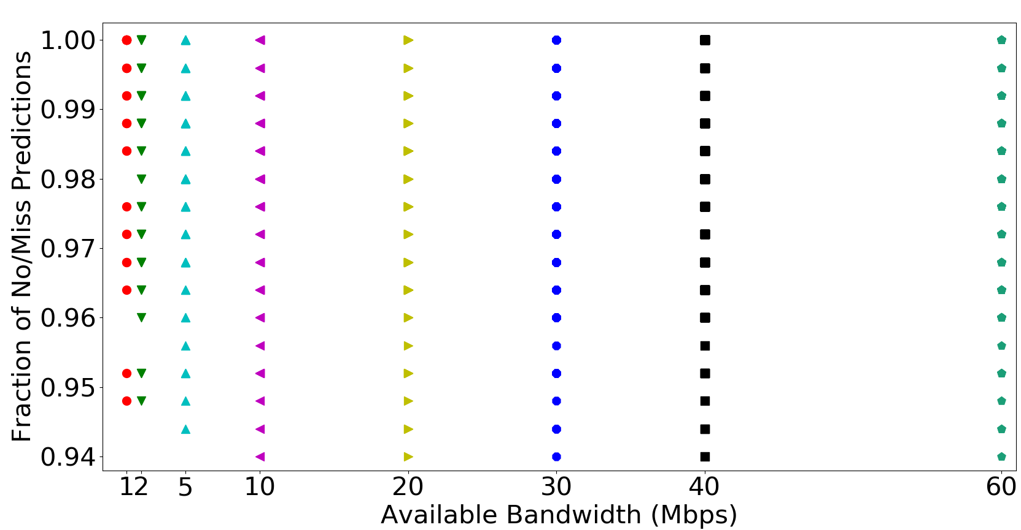
Smaller Model for Drone Captured Images
Use of small model (tiny-yolo) incurs a lot of miss predictions
Almost 94%
Hence, drone captured images requires highly efficient model with high depth for accurate object detection
Notes:
Smaller models are not effective for drone captured images

Slide 39
Conclusion
Best possible configuration in Preprocessing stage changes with the network budget for same content
Network-Aware Approach
Best possible configuration varies from frame-to-frame for fixed network budget
This configuration also different for different contents
Content-Aware Approach

Slide 40
Plans to procced
List all the video features (search more on CVPR)
Feed them into regression model
Find out what video features are relevant
One generalized model will decide all operators
Reinforcement learning
Probabilistic Model

Slide 41
How to Map Relevant Video Features to Best Config??
Suppose we find out f₁, f₂ as two relevant video features on which best configuration will be dependent
F(f₁, f₂) → Best configuration settings
Same f₁, f₂ can lead to different configuration settings
F is the probabilistic model
Regression/Ranking/DNN model
Best Configuration Space
f₂
Clustering
f₁

Slide 42
System Design
1st component
2nd component
Small Video Segments
Extract Video Content Features
Lightweight ML model
(vid_{f1}, vid_{f2})
Optimal Operator Config
Network BW Budget (B)
Apply this likely optimal operator configuration output in the preprocessing stage

Slide 43
Applying parameter tuning on each and every frame might be costly
Hence, let’s look into the approximate operator tuning

Slide 44
Approximate Parameter Tuning-I
for (i = 0; i<n; i++)
if (i%approx_level == 0)
result = compute_result()
approx_level = 5,
Accuracy degradation → 3% (mean)
approx_level =10,
5.5% (mean)
>13% (stdev)
Fixed approximation level is not good…

Slide 45
Approximate Parameter Tuning-II
for (i = 0; i<n; i++)
if (i%approx_level == 0) && (trigger)
result = compute_result()
Triggering only happens when the previous accuracy degrades a lot
approx_level =10,
3% (mean)
>8% (stdev)

Slide 46
Approximate Parameter Tuning-III
for (i = 0; i<n; i++)
if (trigger)
result = compute_result()
Triggering only happens when the previous accuracy degrades a lot
3.2% (mean)
9% (stdev)
How much degradation is concerning needs to be determined

Slide 47
Approximate Parameter Tuning-IV
for (i = 0; i<n; i++)
result = compute_avg_result(period)
Notes:
Period=5
1.5% (mean)

Slide 48
Thank You.. ☺

Slide 49
 | Video₁ |  |  | Video₂ |  |  | Video₃ |  |  | Video₄ |  |  | All videos combined
Train set | 166 |  |  | 178 |  |  | 142 |  |  | 95 |  |  | 584
Test set | 83 |  |  | 88 |  |  | 72 |  |  | 47 |  |  | 290
 | BC | DT | LR | BC | DT | LR | BC | DT | LR | BC | DT | LR | BC | DT | LR
Top-5 | 14 | 19 | 22 | 18 | 15 | 51 | 6 | 12 | 22 | 17 | 2 | 15 | 75 | 49 | 56
Top-10 | 24 | 30 | 37 | 32 | 27 | 62 | 15 | 26 | 32 | 22 | 3 | 22 | 111 | 85 | 76
Top-20 | 50 | 50 | 53 | 54 | 50 | 73 | 21 | 37 | 47 | 32 | 6 | 37 | 181 | 141 | 141
Acc drop | 0.27 | 0.24 | 0.23 | 0.22 | 0.19 | 0.10 | 0.06 | 0.049 | 0.042 | 0.08 | 0.12 | 0.05 | 0.02 | 0.19 | 0.22

Slide 50
System Design II
For each of three techniques, we will design a ML regression model to find the optimum value either for
Resizing parameter for scaling
frequency of offloading
quantization parameter for encoding
Model pool
Model₁ , Model₂ , Model₃
Depending predicted technique
ML Regression model_{i}
(vid_{temp}, vid_{spatial})
Optimum Value used
3rd component
Network BW Budget (B)

Slide 51
Modified Problem Formulation I
Time threshold is fixed and for a particular model on powerful server has very less fluctuation
One can consider the upper bound of detection time (T_{det})
Hence there is fixed budget for communication (T_{comm})
Our transmission frame size < T_{comm} * BW
BW is variable depending on network condition
Send maximal size frame always
Assumption: with higher size (more content) the CNN accuracy will also improve
Is it true always?
No → Adascale [sysML’19]
More content doesn’t imply all are useful.
But is it outliers?
Notes:
After talking with prof (modified idea)

Slide 52
Why Cropping is not Included?
For single object of interest, a cat takes less than 15 percent in an image and background takes rest of it
RoI (Region of Interest) cropping will be a good choice then
But for multiple object detection, multiple RoI boxes can take 80-90% of the large image
RoI cropping will be insignificant
But its still can be used as an orthogonal method with any of this techniques

Slide 53
Problem with choosing Alg, then parameter??
Previous papers talk about the choosing best possible tuning parameter (which can be infinite)
# of algorithms (encoding-decoding, freq reduction) are much less hence easier to explore
But they will interplay with each other finding the best QP value after choosing encoding can perform worse than downsizing parameter in downscaling
Finding algorithm and best parameter inside algorithm are not independent events
Combination of algorithms are possible.
Hence we need to consider them jointly
One model (reinforcement learning) decides which algorithms to choose and what will the hyperparameter value
Since ML is end-2-end, using ML for end-2-end solution will be much better

Slide 54
Detecting 2-dominant objects
Why the variation while changing the downscaling parameter or QP for encoding is less?
The initial resolution sent first convolution layer is 416X416 by default. Hence all images downscaled hugely
2 dominant objects

